Slide 1
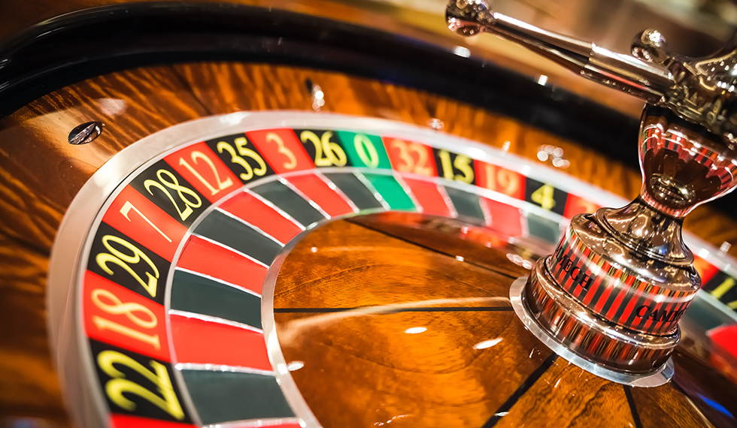
Data Science in Casino
1407 Jin-Yong Seo
1116 Seo-Young Choi

Slide 2
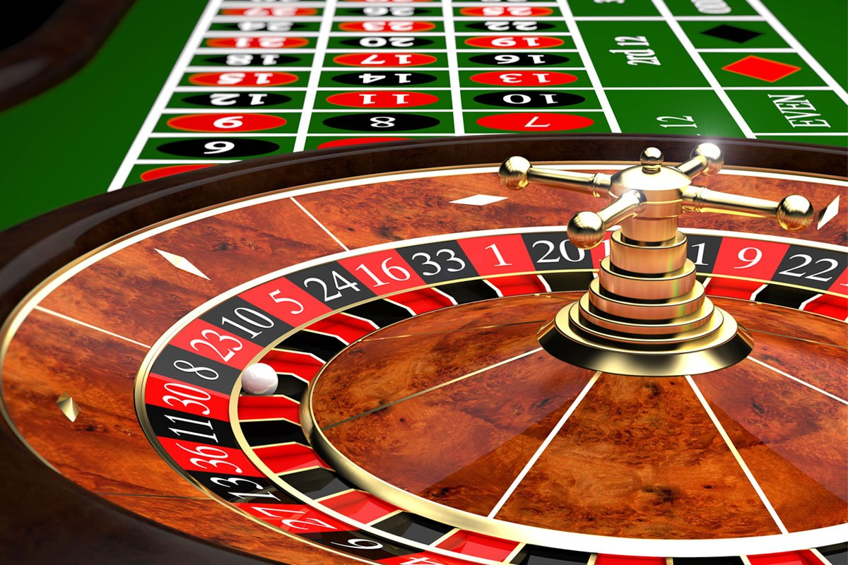
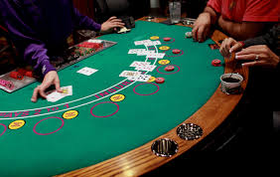
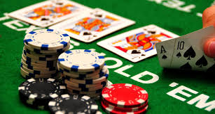
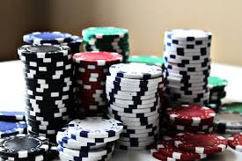
Casino
A casino is a facility for certain types of gambling.
Gambling in Casino
Roulette
Blackjack
Poker
Casino
Chips →

Slide 3




Data Science and Casino?
Case of Prof. Loveman and Harrah’s casino
University
Harrah’s casino
Who’s Prof. Loveman?
Prof. Loveman

Slide 4
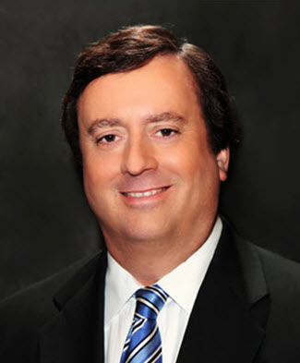
About Prof. Loveman
Brief history
Name: Gary William Loveman
Professor of Havard Business School
COO of Harrah’s Entertainment
CEO of Caesars Entertainment Corporation
COO: administrate daily operation of the company
CEO: most senior administrative officer in charge of managing an organization

Slide 5





Prof. Loveman and Harrah’s casino
Harrah’s
competitor

Slide 6

Summary
Harrah’s didn’t have customers
→ Made a database of the customers
→ But, customers still go to other casino
Loveman → COO
Used database
1. Increased loyalty of members
2. Hire Professional menpower of analyzing data
3. Used analyzed data to marketing
A database is an organized collection of data, generally stored and accessed electronically from a computer system.

Slide 7
About Data Science Used in this case
Prof. Loveman
Grade customer of money they used, how many they came
Give a service they want
Ex) collected 1 TB data of 28million members
if their loss gets larger so that they want to quit gambling, provide free meal or ticket to make them stay in the hotel

Slide 8
Usage plan of data science in Casino
Our Ideas
Make customer’s data of how many they wins
Lead to low-percentage game or which dealer is good when the customer’s skills are good

Slide 9
Sources
https://www.flaticon.com/
https://en.wikipedia.org/wiki/Chief_executive_officer
https://en.wikipedia.org/wiki/Chief_operating_officer
https://en.wikipedia.org/wiki/Gary_Loveman
https://weekly.donga.com/3/all/11/99029/1
https://hbr.org/2003/05/diamonds-in-the-data-mine

Slide 10
Thank You!

